Slide 1
Scientific Programming
Artificial Neural Networks
Ankara University
Computer Engineering

Slide 2
What is an Artificial Neural Network?
Artificial neural network is a computing system that is designed to model the way in which the brain performs a particular task or function of interest; usually
implemented by using electronic components
or simulated in software on a computer
Our interest will mostly be on a group of ANNs which do useful computations after a learning process
As the name implies, it is a network of smaller computing units called neurons
<number>
Notes:
<number>

Slide 3
Benefits of ANNs
Parallelism
Learning
Generalization
Adaptability
Fault Tolerance and Flexibility
Working with Missing Data
<number>
Notes:
<number>

Slide 4
Artificial Neural Networks Areas
Computational Finance: Credit scoring, Algorithmic trading
Image Processing and Computer Vision: Face recognition, motion detection, object detection
Computational Biology: tumor detection, drug discovery, DNA sequencing
Energy Production: Price and load forecasting
Automotive, aerospace and manufacturing: Predictive maintenance
Natural Language Processing: Voice assistant, emotion analysis
<number>
Notes:
<number>

Slide 5
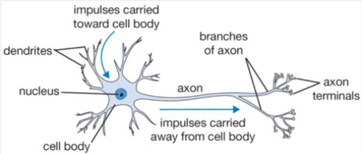
Human Brain
<number>
Notes:
<number>

Slide 6
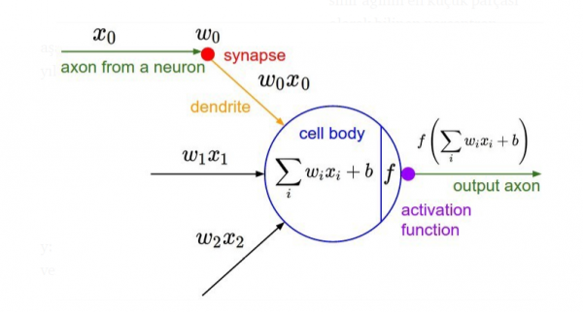
Artificial Neuron Models
<number>
Notes:
<number>

Slide 7
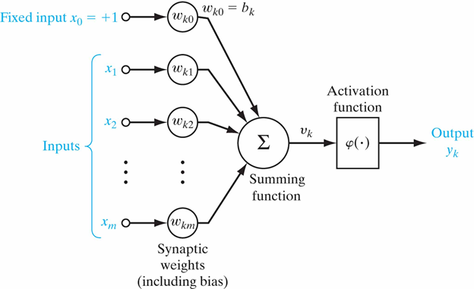
Artificial Neuron Models
Formed by the interconnection of artificial neuron cells.
An artificial neuron/perceptron consists of five parts;
Inputs
Weights
Summing function
Activation function
Outputs
<number>
Notes:
<number>

Slide 8
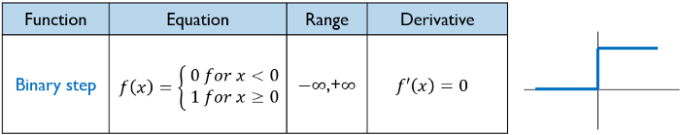
Types of Activation Function
The activation function (φ(v)) defines the output of a neuron in terms of the activation potential v_{k}
Step function
hardlim is a Matlab neural transfer function. Transfer functions calculate a layer’s output from its net input.
Assign this transfer function to layer i of a network.
net.layers{i}.transferFcn = 'hardlim';
<number>
Notes:
<number>

Slide 9
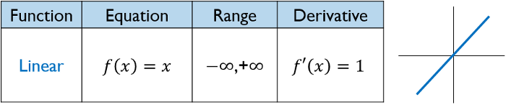
Types of Activation Function
Linear function
purelin is a Matlab neural transfer function. Transfer functions calculate a layer’s output from its net input.
Assign this transfer function to layer i of a network.
net.layers{i}.transferFcn = 'purelin';
<number>
Notes:
<number>

Slide 10
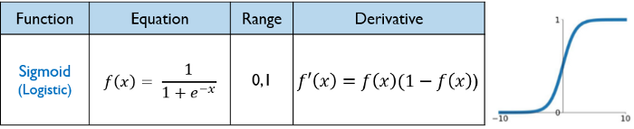
Types of Activation Function
Non-linear Function
Sigmoid function
logsig is a Matlab neural transfer function. Transfer functions calculate a layer’s output from its net input.
Assign this transfer function to layer i of a network.
net.layers{i}.transferFcn = 'logsig';
<number>
Notes:
<number>

Slide 11
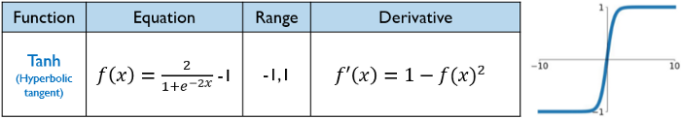
Types of Activation Function
Non-linear Function
Hyperbolic tangent function
tansig is a Matlab neural transfer function. Transfer functions calculate a layer’s output from its net input.
Assign this transfer function to layer i of a network.
net.layers{i}.transferFcn = 'tansig';
<number>
Notes:
<number>

Slide 12
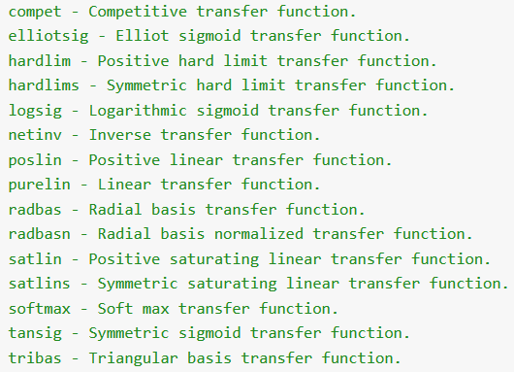
Matlab-Activation Function List
<number>
Notes:
<number>

Slide 13
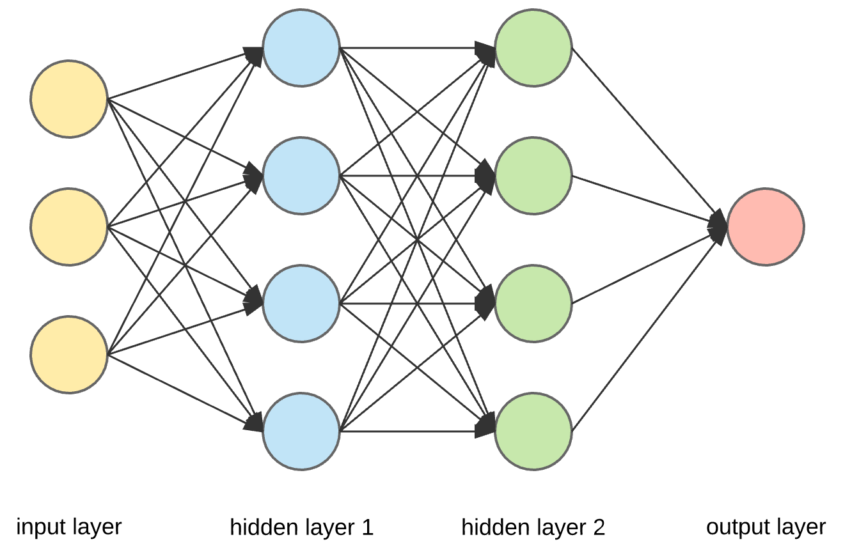
Artificial Neural Networks
Input layer — initial data for the neural network.
Hidden layers — intermediate layer between input and output layer and place where all the computation is done..
Output layer — produce the result for given inputs.
<number>
Notes:
<number>

Slide 14
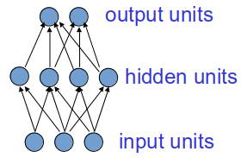
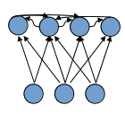
Types of Connectivity
Feedforward networks
These compute a series of transformations
Typically, the first layer is the input and the last layer is the output.
Recurrent networks
These have directed cycles in their connection graph. They can have complicated dynamics.
More biologically realistic.
<number>
Notes:
<number>

Slide 15
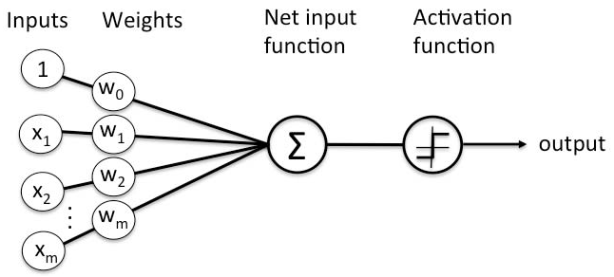
Different ANN Topologies
Single layer feed-forward networks
Single layer neural networks consist of only input and output layers.
The simplest single layer neural network model is the perceptron.
A Perceptron is an algorithm for supervised learning of binary classifiers.
<number>
Notes:
<number>

Slide 16
Weight Calculation
In general two basic methods can be employed to select a suitable weight vector:
By off-line calculation of weights.
By learning procedure.
Once the weights are selected, then the perceptron performs its desired task.
<number>
Notes:
<number>

Slide 17
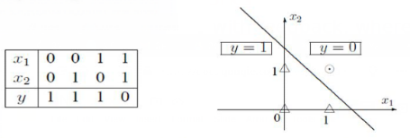
Different ANN Topologies
Perceptron - Example
The problem of building the NAND gate using the perceptron.
The decision plane:
x₁ + x₂ = 1.5 or -x₁ - x₂ + 1.5 = 0
<number>
Notes:
<number>

Slide 18


Different ANN Topologies
Perceptron - Example
The weight vector for the decision line -x₁ - x₂ + 1.5 = 0 :
w = [-1 -1 1.5]
Activation function and output signal
<number>
Notes:
<number>

Slide 19
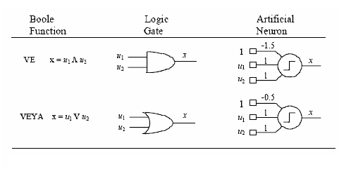
Different ANN Topologies
Perceptron
<number>
Notes:
<number>

Slide 20
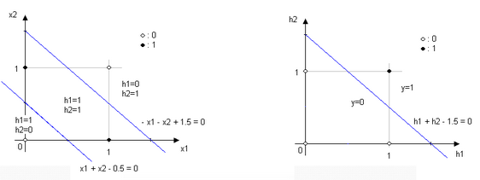
Different ANN Topologies
Multi-layer feed-forward networks
Linear separation is impossible by using a perceptron.
Use hidden layer(s): It transforms the input space into a hidden layer space that facilitates decision making.
<number>
Notes:
<number>

Slide 21
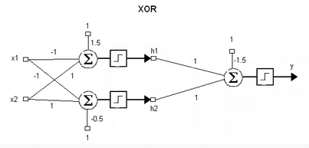
Different ANN Topologies
Multi-layer feed-forward networks
<number>
Notes:
<number>

Slide 22
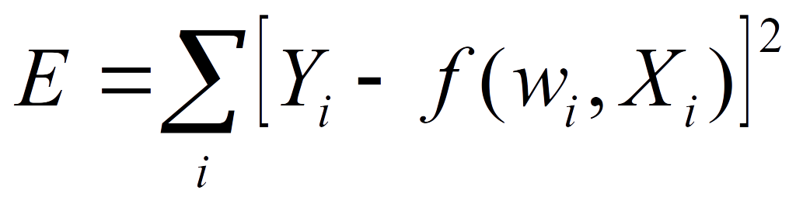
Algorithm for Learning Weights
Initialize the weights (w₀, w₁, …, w_{k})
Adjust the weights based on error
Error function:
Find the weights that minimize the error
<number>
Notes:
<number>

Slide 23
Backpropagation Algorithm
Iteratively process a set of training tuples
Compare the network's prediction with the actual target value
To minimize the error between the network's prediction and the actual target value, modify the weights.
Modifications are made in the “backwards” direction: from the output layer, through each hidden layer down to the first hidden layer (“backpropagation”)
<number>
Notes:
<number>

Slide 24
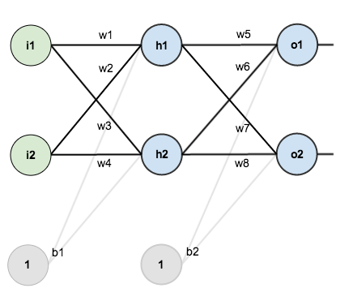
Backpropagation Algorithm - Example
Network: a neural network with two inputs, two hidden neurons, two output neurons.
Goal: To optimize the weights so that the neural network can learn how to correctly map arbitrary inputs to outputs.
<number>
Notes:
<number>

Slide 25
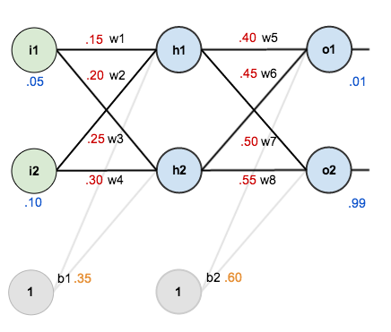
Backpropagation algorithm - Example
Inputs: 0.05 and 0.10
Outputs: 0.01 and 0.99
Network with the initial weights, the biases, and training inputs/outputs:
<number>
Notes:
<number>

Slide 26
Backpropagation algorithm - Example
The Forward Pass
Calculate the total net input for h₁:
After applying activation function:
Carrying out the same process for h₂
<number>
Notes:
<number>

Slide 27
Backpropagation algorithm - Example
Repeat process for the output layer neurons (using the output from the hidden layer neurons as inputs)
Carrying out the same process for o₂
<number>
Notes:
<number>

Slide 28
Backpropagation algorithm - Example
Calculating the Total Error
The target output for o₁: 0.01
Network output: 0.75136507
The target output for o₂: 0.99
Network output: 0.772928465
The total error for the neural network = the sum of E_{o1}+ E_{o2}
<number>
Notes:
<number>

Slide 29

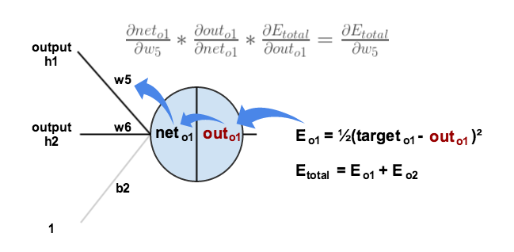

Backpropagation algorithm - Example
The Backwards Pass
Output Layer
Consider w₅.
We want to know how much a change in w₅ affects the total error
<number>
Notes:
<number>

Slide 30

Backpropagation algorithm - Example
First, how much does the total error change with respect to the output?
Next, how much does the output of o₁change with respect to its total net input?
<number>
Notes:
<number>

Slide 31

Backpropagation algorithm - Example
Finally, how much does the total net input of o₁change with respect to w₅?
Putting it all together:
<number>
Notes:
<number>

Slide 32



Backpropagation algorithm - Example
To decrease the error, subtract this value from the current weight (optionally multiplied by some learning rate, eta, which we’ll set to 0.5):
Repeat this process to get the new weights w₆,w₇ and w_{8:}
<number>
Notes:
<number>

Slide 33
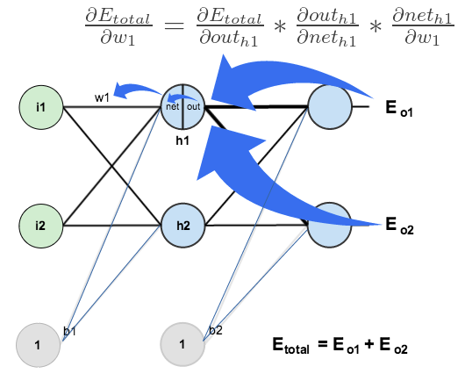
Backpropagation algorithm - Example
Hidden Layer
Continue the backwards pass by calculating new values for w₁, w₂, w₃ and w₄.
<number>
Notes:
<number>

Slide 34






Backpropagation algorithm - Example
<number>
Notes:
<number>

Slide 35


Backpropagation algorithm - Example
Calculate the partial derivative of the total net input to h₁ with respect to w₁
Putting it all together:
<number>
Notes:
<number>

Slide 36



Backpropagation algorithm - Example
Now update w₁
Repeating this for w₂, w₃ and w₄
<number>
Notes:
<number>

Slide 37
Backpropagation algorithm - Example
Finally, all of the weights were updated.
The first error on the network: 0.298371109.
After this first round of backpropagation, the total error: 0.291027924.
After repeating this process 10,000 times, the total error: 0.0000351085.
At this point, the two outputs neurons generate 0.015912196 (vs 0.01 target) and 0.984065734 (vs 0.99 target).
<number>
Notes:
<number>

Slide 38
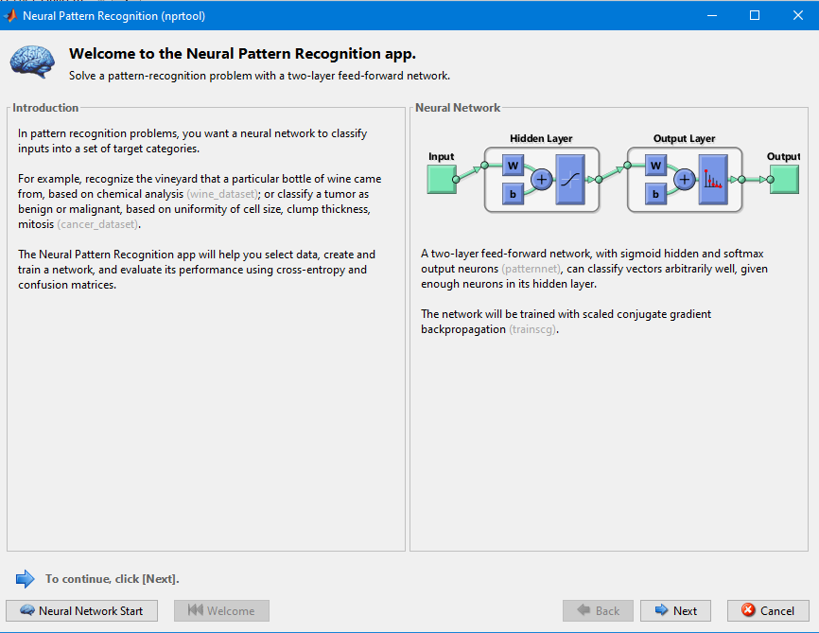
MATLAB Neural Pattern Recognition Example - nprtool
<number>
Notes:
<number>

Slide 39
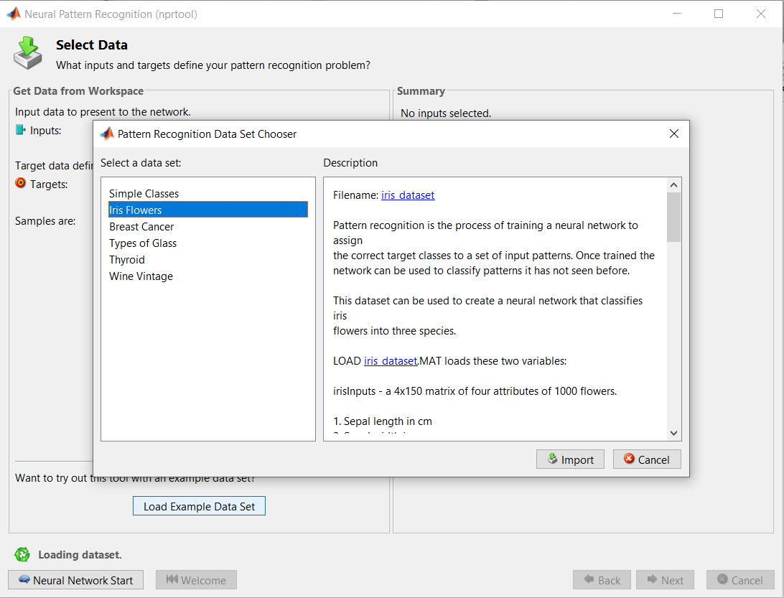
MATLAB Neural Pattern Recognition Example
<number>
Notes:
<number>

Slide 40
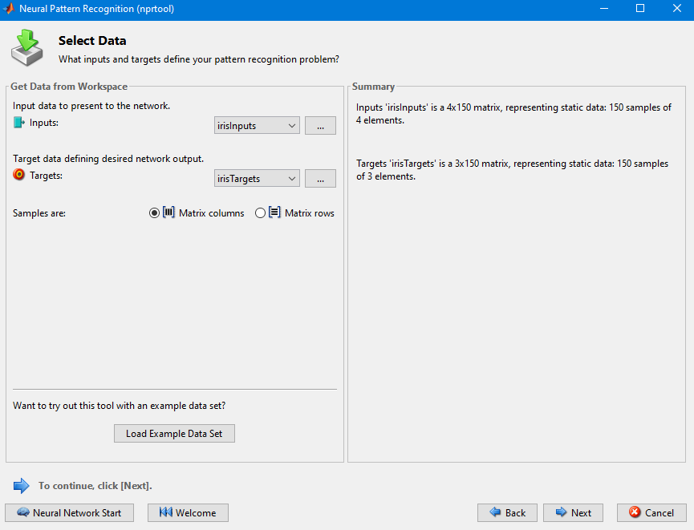
MATLAB Neural Pattern Recognition Example
<number>
Notes:
<number>

Slide 41
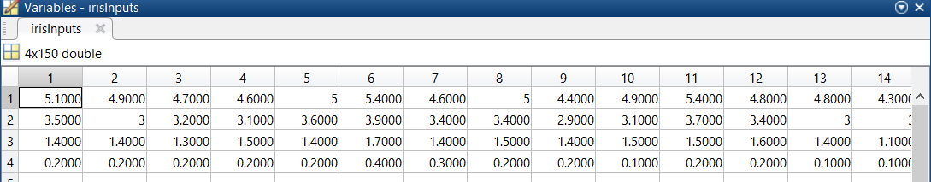
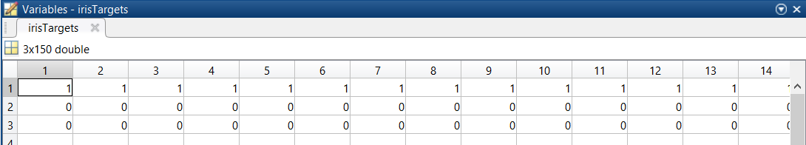
IRIS DATA SET
Number of Instances: 150 (50 in each of three classes)
Number of Attributes: 4 numeric, predictive attributes and the class
Attribute Information:
sepal length in cm
sepal width in cm
petal length in cm
petal width in cm
class: -- Iris Setosa -- Iris Versicolour -- Iris Virginica
<number>
Notes:
<number>

Slide 42
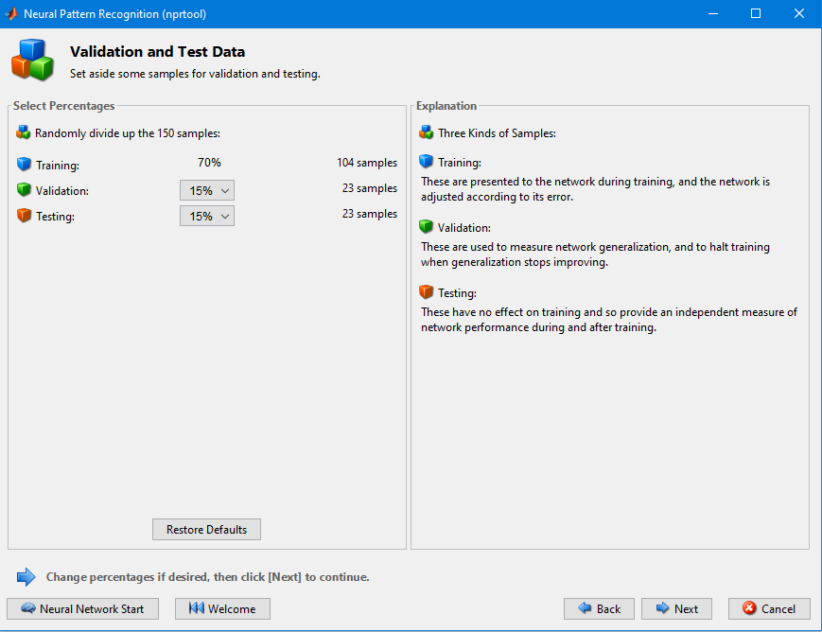
MATLAB Neural Pattern Recognition Example
<number>
Notes:
<number>

Slide 43
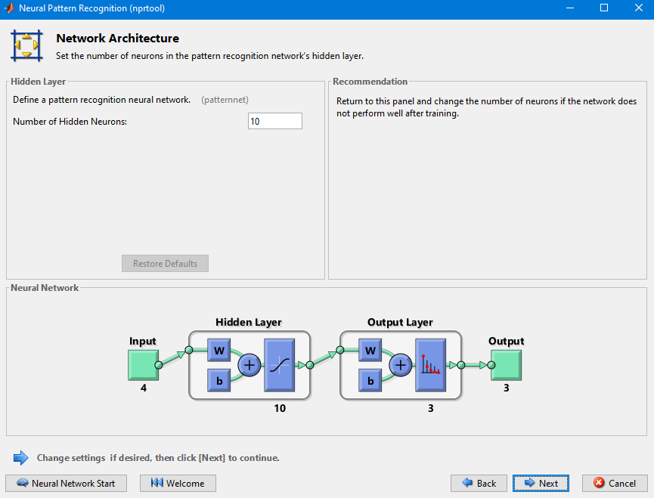
MATLAB Neural Pattern Recognition Example
<number>
Notes:
<number>

Slide 44
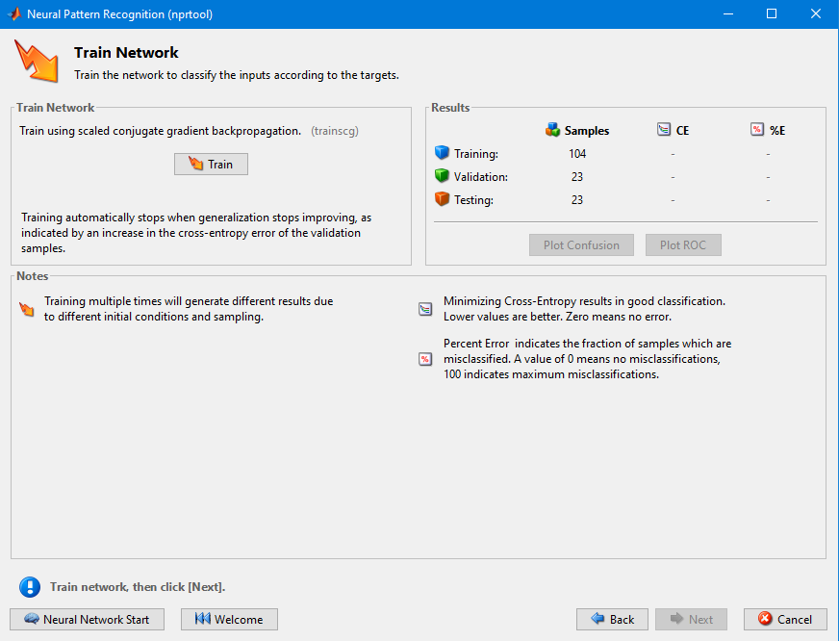
MATLAB Neural Pattern Recognition Example
<number>
Notes:
<number>

Slide 45
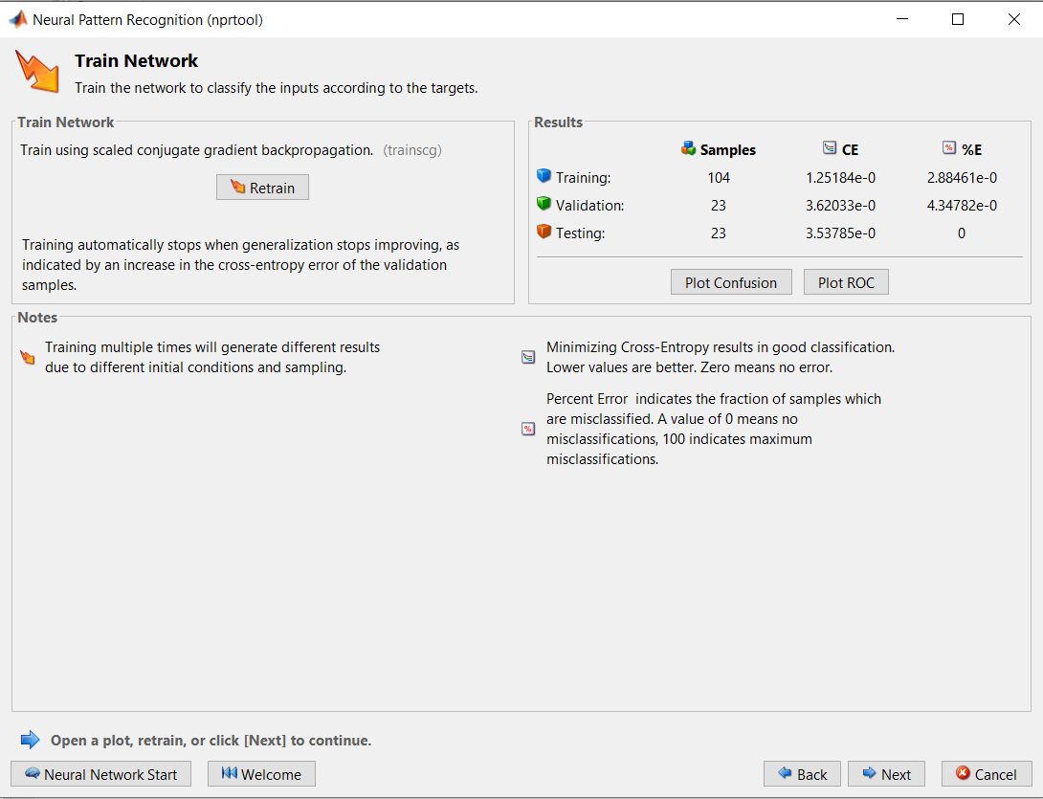
MATLAB Neural Pattern Recognition Example
<number>
Notes:
<number>

Slide 46
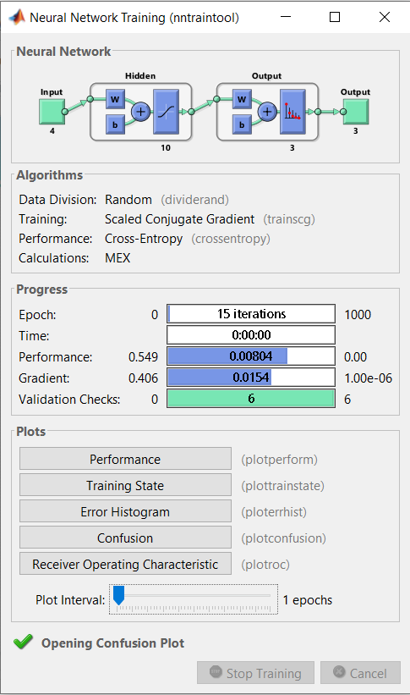
MATLAB Neural Pattern Recognition Example
<number>
Notes:
<number>

Slide 47
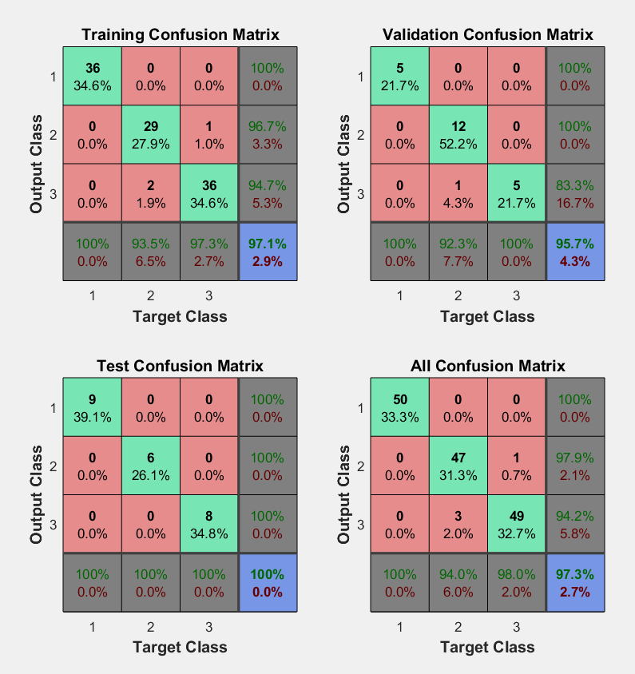
MATLAB Neural Pattern Recognition Example
<number>
Notes:
<number>

Slide 48
MATLAB Neural Pattern Recognition Example
[x,t] = iris_dataset;
net = patternnet(10);
net = train(net,x,t);
view(net)
y = net(x);
plotconfusion(t,y)
<number>
Notes:
<number>

